Slide 1
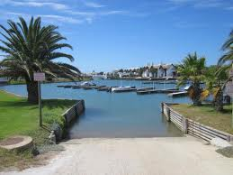
St Francis
Business Chamber
Vision 2030

Slide 2
Agenda - St Francis 2030
A World Class Start
Chamber Vision Chamber Objectives
Projects
Q & A

Slide 3
St Francis - A World Class Start
Inception
1954 – St Francis Bay conceived By Leighton Hulett & Friends
Vision
Use & enhanced the beautiful and natural elements
Create an enclave that delivers a premium life-style
Implement quality based aesthetics
Minimises the impact on the environment
Positioning
Preeminent Holiday & retirement village for business leaders
Both in South Africa and Internationally
Resent History
Minimal investment in infrastructure & slow degradation of the town*
        * As A Result of a lack of upkeep
        * Relative to Newer Developments

Slide 4
The Competition
Towns
Knysna, Plett, Franschhoek, Dullstroom, Sabie, Umhlunga.
Life Style Interests
Conservation/ Game , Fishing & Dams, Mountains, Golf, Wine.
Developments
Plettenberg Bay, Zimbali, Thesens Island, Fancourt, etc.
Investors now have many choices!
The Challenge
Develop strategies & plans that enhance our location offering
Open up opportunities, attract investors & tourists
Create Partnerships for success

Slide 5
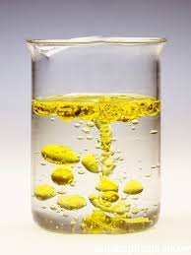
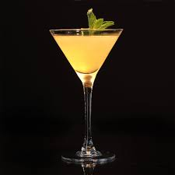
St Francis
Working Together!

Slide 6
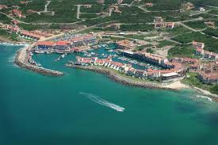
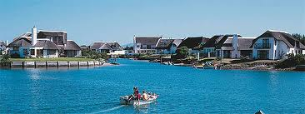
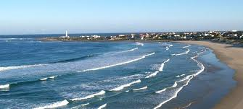
St Francis Business Chamber
Chamber Mission
“To effectively promote & protect the interests of business”
St Francis is good for Business
& Business is good for St Francis

Slide 7
Chamber Objectives
1/2
Ensure that the interests of business is heard where it matters
Formulate policy & consolidate the viewpoint of business on key issues that affect it
Influence constructively the environment in which business operates
Help business to adapt to realities that cannot be changed
Assist members to network & grow their business
Fulfil a leading role in the community in which we operate & live
Promote private enterprise systems & market-orientated approach
“ St Francis is Good for Business
& Business is Good for St Francis”
“ St Francis is Good for Business
& Business is Good for St Francis”

Slide 8
Chamber Objectives
2/2
Promote equal opportunities regardless of race, gender or religion
Work with local, regional and central government to develop public private partnerships for the benefit of all
Provide mentoring programs for the previously disenfranchised to encourage economic development
Ensure adequate protection of the interests of business
Ensure that the highest standard of business principles, practices and ethics apply
The St Francis Business Chamber will remain apolitical.
“Be the voice of business”
“ St Francis is Good for Business
& Business is Good for St Francis”

Slide 9
Thyspunt
We can try and Ignore It
Continue Fighting Nuclear
Results - When & if its Built we will still have
    Concerns about the environment
    Impact on the area
But with no benefits!
Nuclear may never happen
but we must be prepared
Successful Businesses are proactive
Embrace nuclear as has business in Jeffreys & Humansdorp
Manage or mitigate the impact on our villages
Take advantage of the opportunities

Slide 10



The Way Forward
We galvanise ourselves
into a democratic community.
  We work with the municipality.
We earn credibility by putting our money where our mouths are.
  We raise funds.
We market the positives
  We get early wins
“ St Francis is Good for Business
& Business is Good for St Francis”

Slide 11
St Francis Projects
Projects will enhance the desirability for existing and new business to make St Francis & Kouga their home base
Project will enhance the areas infrastructure
Projects will add value to the environment and attract visitors while opening up opportunities for Small Business Enterprises
“Projects will add value to the community in which we live !”
“ St Francis is Good for Business
& Business is Good for St Francis”

Slide 12
What needs to be done – Project Examples
Private & Public Initiatives
General Signage
The Village Green
The Village Common
Entrance to SFB
The SFB Boardwalk
Heritage Centre
Riparian/Homeowners/
Kromme Trust
The Cove
Shore road
Canal Entrance
6 Bridges on the canals
Small Boat Harbour
BHAP’S
(Big Hairy Audacious Problems)
Roads
Beach
Waterside Entertainment
Hotel
Public – Private Initiatives
Hospital
School
Airport - Airpark
Industrial Development zone
The upgrade of Sea Vista
“ St Francis is Good for Business
& Business is Good for St Francis”

Slide 13
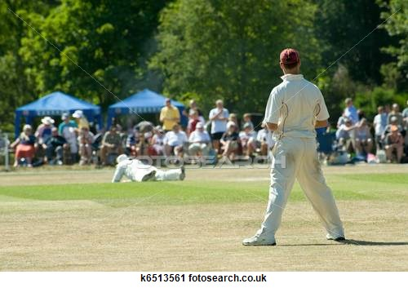

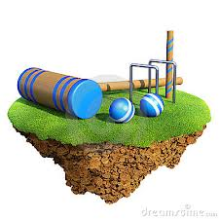


St Francis Village Common
St Francis Village Common
Cricket/ Crought / Village Sports / Family Events

Slide 14
Project Name: : The Village Common
Key Objectives
Create an environment that will enhance village credentials
Old style village cricket pitch with clubhouse for social events
Landscape gardens, water features and lighting
Expand sports facilities for all
Project Members
* Greg Darke
* John Hammond
Project - Lead Contact
Greg Darke 083 601 4848
“ St Francis is Good for Business
& Business is Good for St Francis”

Slide 15
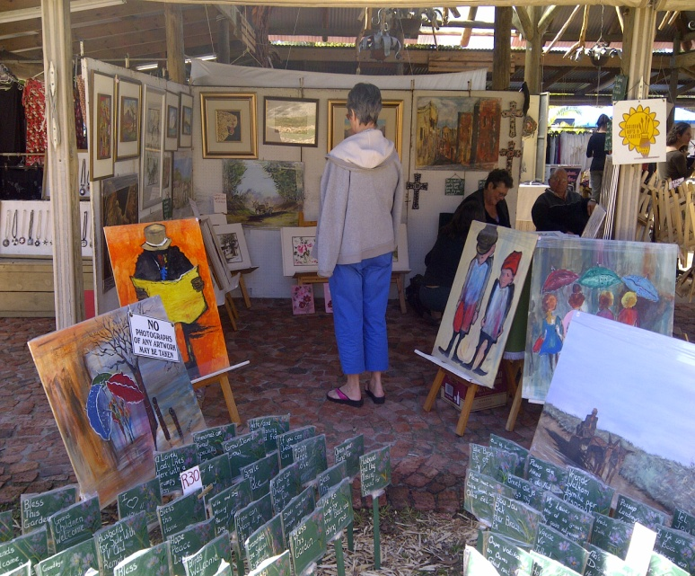

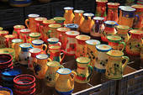
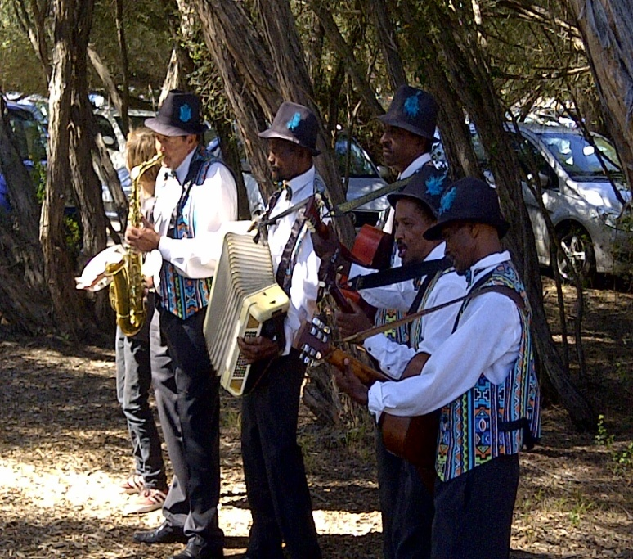
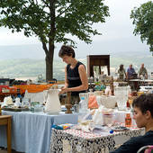
St Francis Village
Market

Slide 16
Project Name: : The Village Green
Key Objectives
Create a centre for village social events and relaxation
Create an environment for Village Markets
Recreational area with band stand for small music & religious events such as Christmas
Landscape gardens, water features and lighting
Project Members
* Theo Stead
* Tessa Suckling + Team
* John Hammond
* Trevor Tennant
Project - Lead Contact
Theo Stead 072 197 6238
“ St Francis is Good for Business
& Business is Good for St Francis”

Slide 17



St Francis Business
Education &
Training

Slide 18
Project Name: : Education & Training
Key Objectives
Create a centre of knowledge
Identify relevant course material
Create partnerships with educational institutes
Partner with Public programs
Project Members
* Pete Bridges
* Theo Stead
Project - Lead Contact
Pete Bridges - 082 468 2242
“ St Francis is Good for Business
& Business is Good for St Francis”

Slide 19
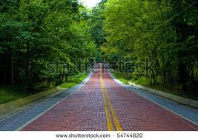
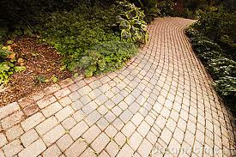
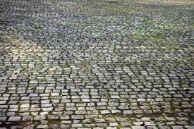
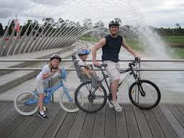

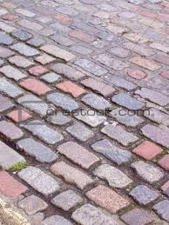
Village Roads
&
Paving

Slide 20
Project Name: : The Village Infrastructure
Key Objectives
Develop a strategy for replacement or upgrade of road infrastructure
Create partnership that will contribute skills, knowledge & funds
Raise funding from public and private institutions and residents
Project Members
* John Hammond
* Garth Perry
* Athol Hodgekinson
* Duncan Letbridge
Project Lead Contact
John Hammond 072 770 7788
“ St Francis is Good for Business
& Business is Good for St Francis”

Slide 21
Project Ideas
The Village Green
Coastal Board Walk
Hospital or Clinic
Sports Facilities / Cycling & Running Track
St Francis Radio Station
Cobble Roads / Signage
Airport
River & Coastal Development
Free Wi-Fi Zone
What Ideas
do you
have?
“ St Francis is Good for Business
& Business is Good for St Francis”

Slide 22
Project Ideas
Christmas Lighting
Chokka Trail / Slack packers
Tourism Transport
African Village for Cultural lifestyle, Crafts
Sea Vista Retail Tourism
Business Education / Incubator / Incentives
Hotel
Safety and Security
What Ideas
do you
have?
Projects will be consolidated into a St Francis Business Plan 2030
This will be converted into a marketing document to promote St Francis & attract investment from residential, business & tourism segments
“ St Francis is Good for Business
& Business is Good for St Francis”

Slide 23
Business Chamber
Standing Committee
Working Groups
Advisory Board
Project Leaders
Senior Executives + Retired Leaders
Geo/Gender Groups
Business Forum
Education & Training
Kromme Trust
Fund Raising & Finance
Ratepayers Association
Marketing, Tourism & Communications
ETC.
“ St Francis is Good for Business
& Business is Good for St Francis”

Slide 24
St Francis Business
Summary
Forum & Chamber Partnership
Chamber Vision & Structure
Projects Model
St Francis Business Vision 2030
Partnership with existing bodies
Protect your investment, get involved and Join the Chamber today!
Contact for further info via email: sfbchamber@gmail.com
John : 072 7707788 Theo: 0721976238 Pete: 0824682242
“ St Francis is Good for Business
& Business is Good for St Francis”

Slide 25
Chamber input Sources
Sample of Individuals with whom discussions have taken place
Discussions have evolved since the last business forum
Frank | Silberbour | Infinity Consulting
Benny | Morsink | Zambli
George | Stegmann | Business Forum
Jeff | Clause | ST Francis Links
Brian | Codling | SFBRA
Pete | Maskew | Advisor
Brian | Cunningham | Brisan B/B
Richard | Moolman | Spar
Garth | Perry | Bush Buck Ridge
Pete | Bridges | Developer
Greg | Darke | Kathea
Shelly | Danaldson | Kouga Print
Brandon | Kennedy | St Francis Pharmacy
Patrick | Howitt | Delish/Investor
Andre | Fouche | Investing Abroad
Brendon | Lahaha | Bay Estates
Paul | Hurley | Hurley Construction
Asandra | Malgas | Sea Vista Chamber
Phumeza | Nkwalase | Sea Vista Chamber
Raymond | Ntengwane | Mojowise Pty
Andrew | Venn | SF Filling Station
Alex | Kandaya | Shenanigans

